Slide 1
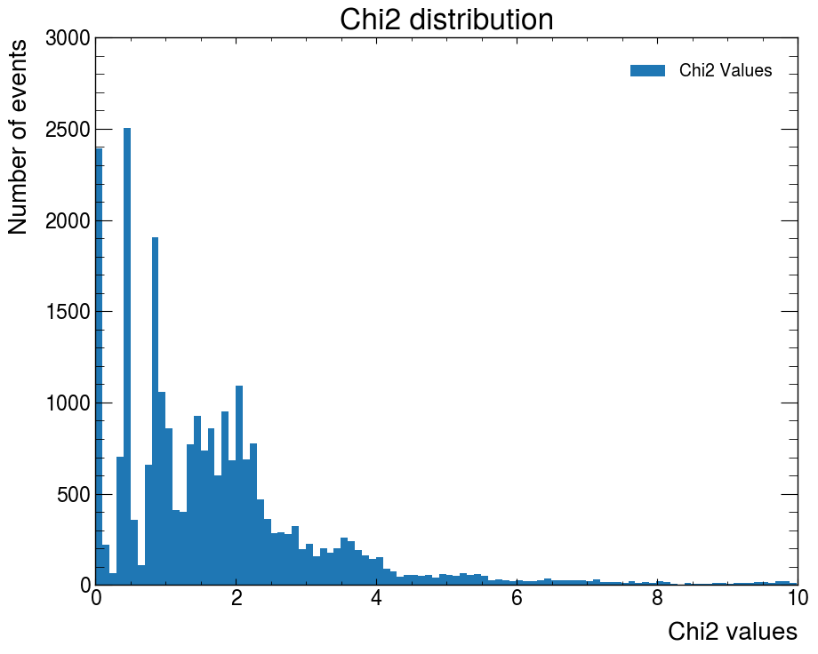
Region 2
Region 3
Region 1
Region 4
Trash
Region 5

Slide 2
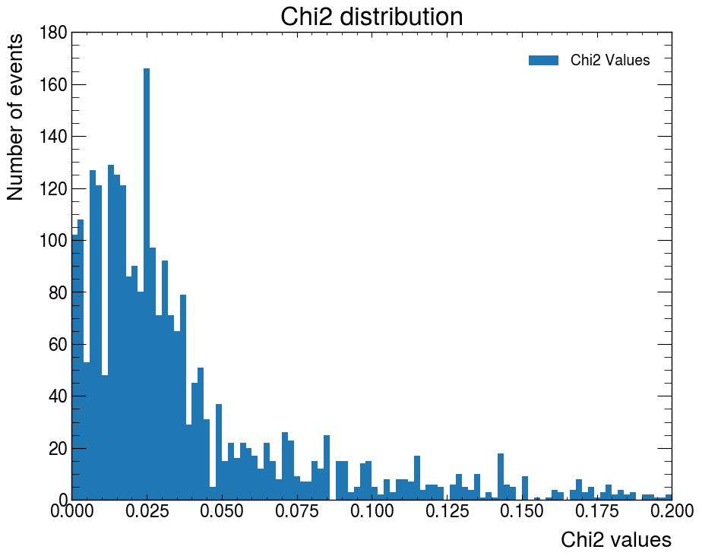
Region 1

Slide 3
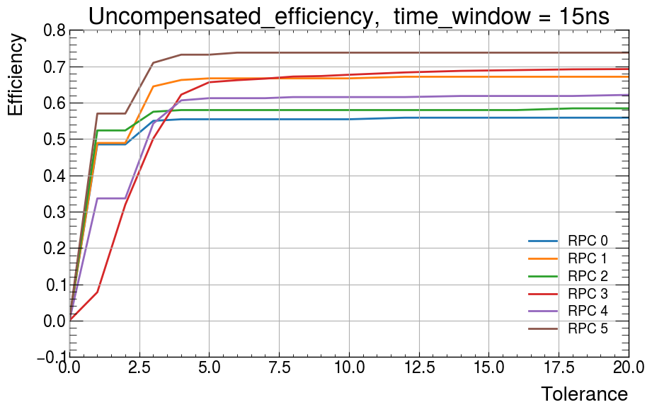
Possible reconstructios without certain RPC
[231, 225, 214, 1407, 330, 179]
RPC3 when removed had most reconstructions
lucky angles due to detector resolution
Step behavior further proves detector resolution, each step is one width of strip

Slide 4
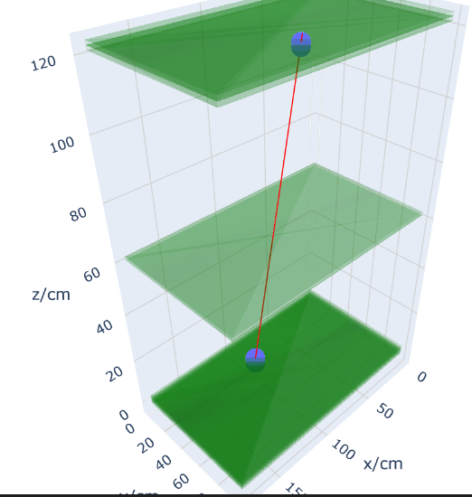
Semi-Random selected events
Geometric effect, lucky angle caused low chi2
[[95.30625, 25.3674, 0.6],
[95.30625, 25.3674, 1.8],
[95.30625, 25.3674, 3.0],
[100.83125000000001, 73.1178, 121.8], [100.83125000000001, 73.1178, 123]]

Slide 5
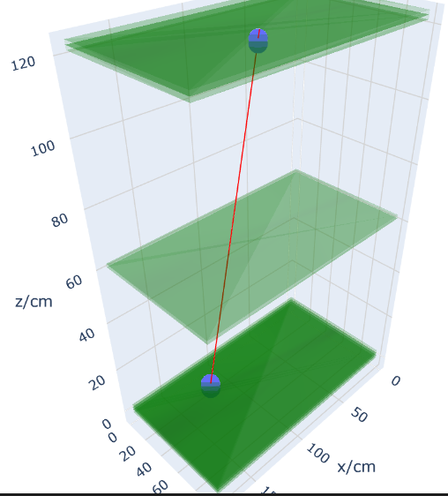
Semi-Random selected events
Geometric effect, lucky angle caused low chi2
[[122.93125, 25.3674, 0.6],
[122.93125, 25.3674, 1.8],
[122.93125, 25.3674, 3.0],
[106.35625, 64.1646, 121.8],
[106.35625, 64.1646, 123]]

Slide 6
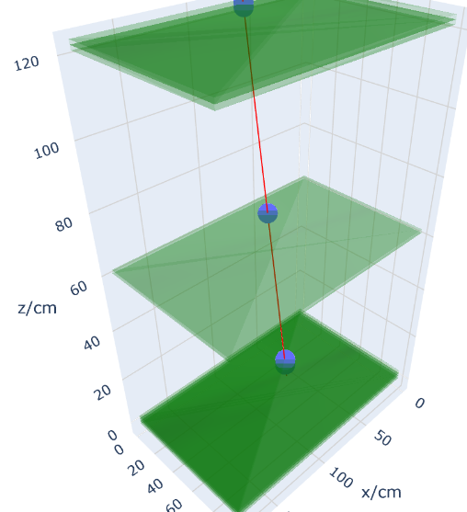
Semi-Random selected events
Gemetric effect with Lucky angles
[[56.63125, 31.336199999999998, 0.6],
[56.63125, 31.336199999999998, 3.0], [59.393750000000004, 16.4142, 61.8], [62.15625000000001, 1.4922, 121.8], [62.15625000000001, 1.4922, 123]]

Slide 7
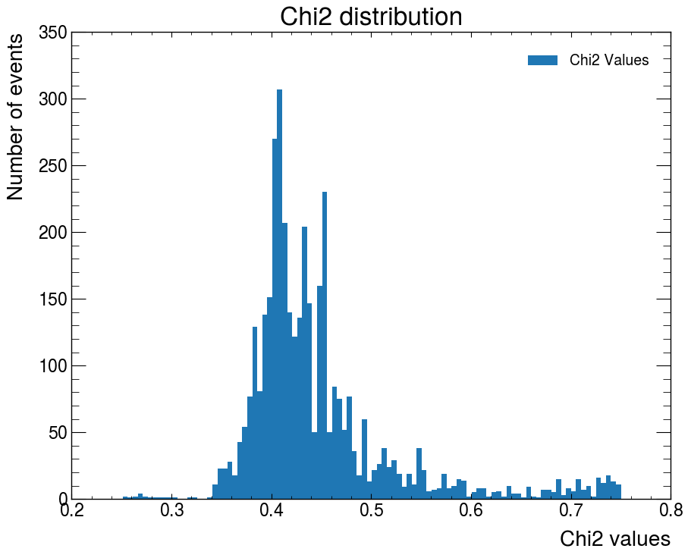
Region 2

Slide 8
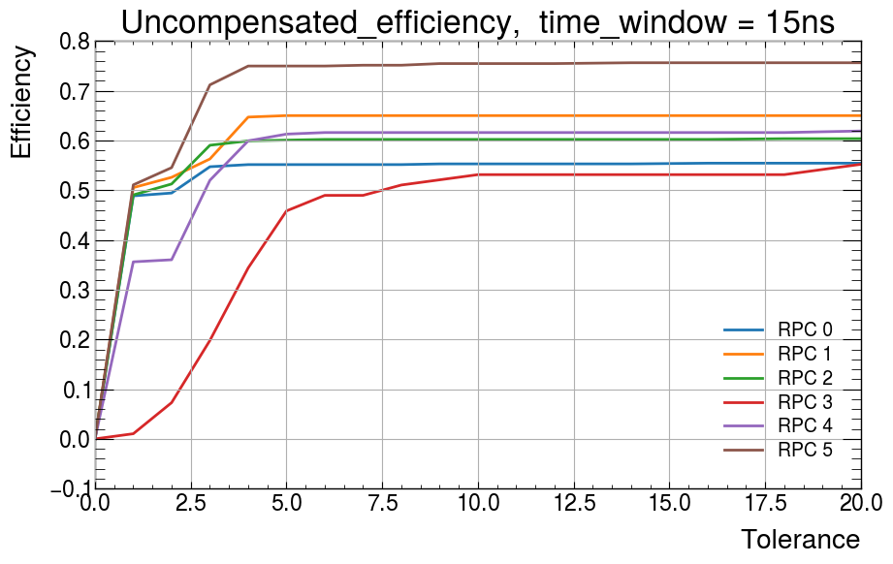
[700, 677, 681, 96, 958, 607]
-Almost no data for RPC3.
-Makes sense since when you remove the middle RPC, pretty much all lines reconstructed using top and bottom chamber will be pushed into the low chi2 region.

Slide 9
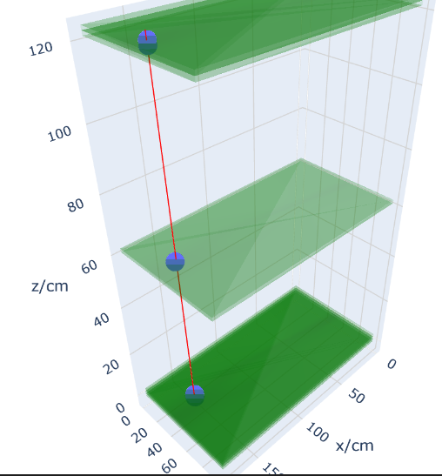
Semi-Random selected events
[[153.31875000000002, 31.336199999999998, 0.6],
[153.31875000000002, 31.336199999999998, 1.8],
[161.60625000000002, 37.305, 61.8], [167.13125000000002, 43.2738, 121.8], [167.13125000000002, 43.2738, 123]]

Slide 10
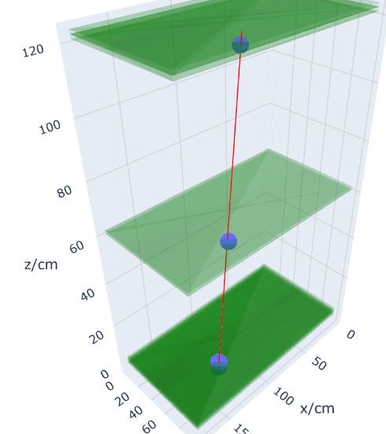
Semi-Random selected events
[[125.69375000000001, 64.1646, 0.6], [125.69375000000001, 64.1646, 1.8], [125.69375000000001, 64.1646, 3.0],
[122.93125, 76.1022, 61.8],
[120.16875, 85.05539999999999, 121.8]]

Slide 11
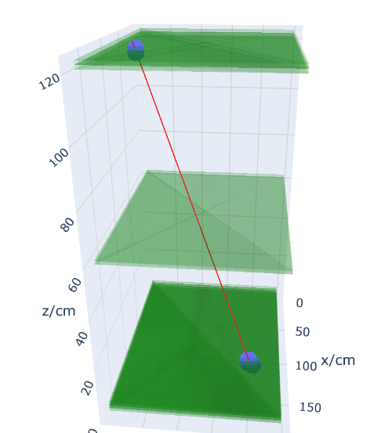
Only occurs if Triplet or doublet had a displacement
[[117.40625000000001, 82.071, 0.6], [117.40625000000001, 79.0866, 1.8], [117.40625000000001, 79.0866, 3.0], [117.40625000000001, 16.4142, 121.8],
[117.40625000000001, 16.4142, 123]]

Slide 12
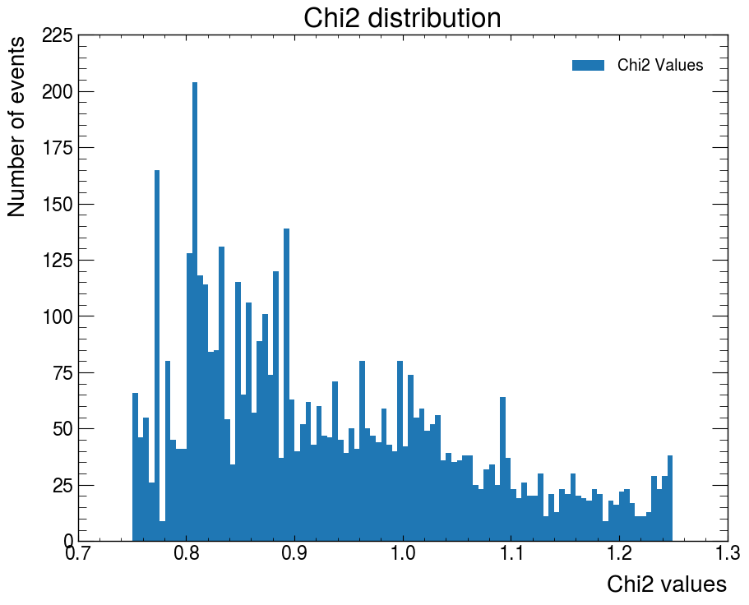
Region 3

Slide 13
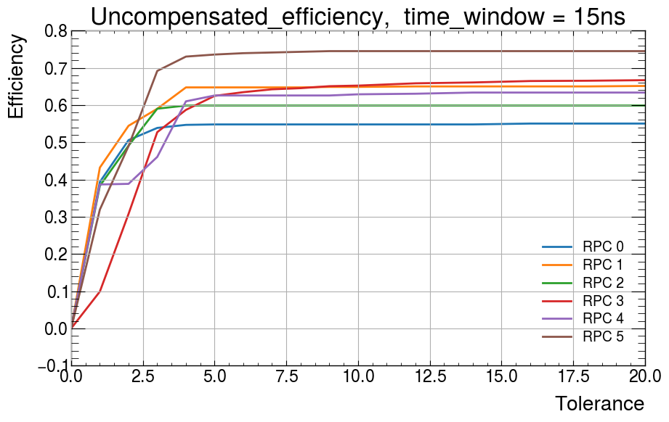
[854, 766, 825, 1303, 636, 545]
In general, this peak is caused by events in triplet or doublet where one or more RPC got a first hit time cluster 2 to 4cm away (1 strip) to what the rests are
Stil within tolerant range of our cluster size so no worries

Slide 14
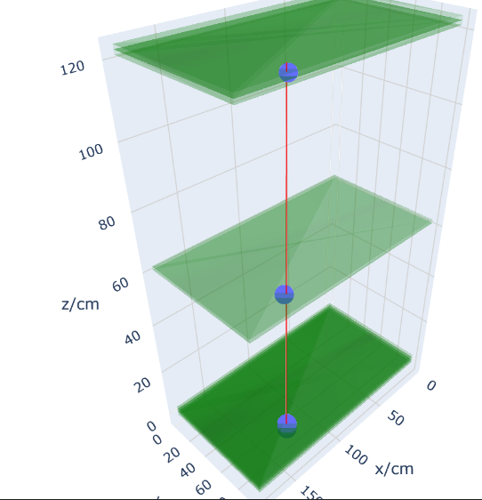
Semi-Random selected events
RPC4 under test
[[128.45625, 73.1178, 0.6],
[128.45625, 73.1178, 1.8],
[128.45625, 73.1178, 3.0],
[136.74375, 82.071, 61.8],
[142.26875, 94.0086, 123]]

Slide 15
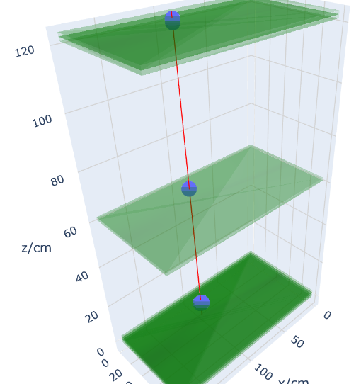
Semi-Random selected events
[[95.30625, 19.3986, 1.8],
[95.30625, 22.383, 3.0],
[98.06875000000001, 19.3986, 61.8], [100.83125000000001, 19.3986, 121.8], [100.83125000000001, 19.3986, 123]]

Slide 16
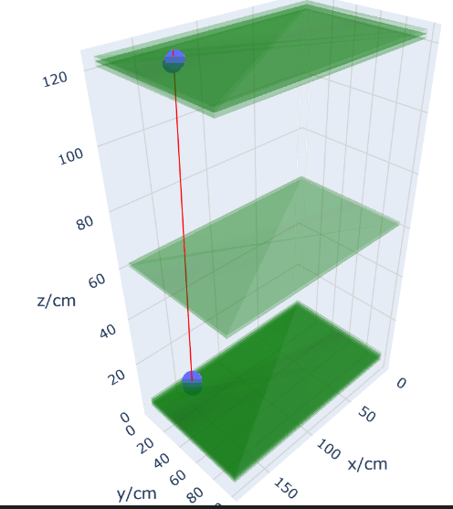
Semi-Random selected events
[[142.26875, 7.461, 0.6],
[142.26875, 7.461, 1.8],
[142.26875, 7.461, 3.0],
[147.79375000000002, 28.3518, 121.8], [147.79375000000002, 31.336199999999998, 123]]

Slide 17
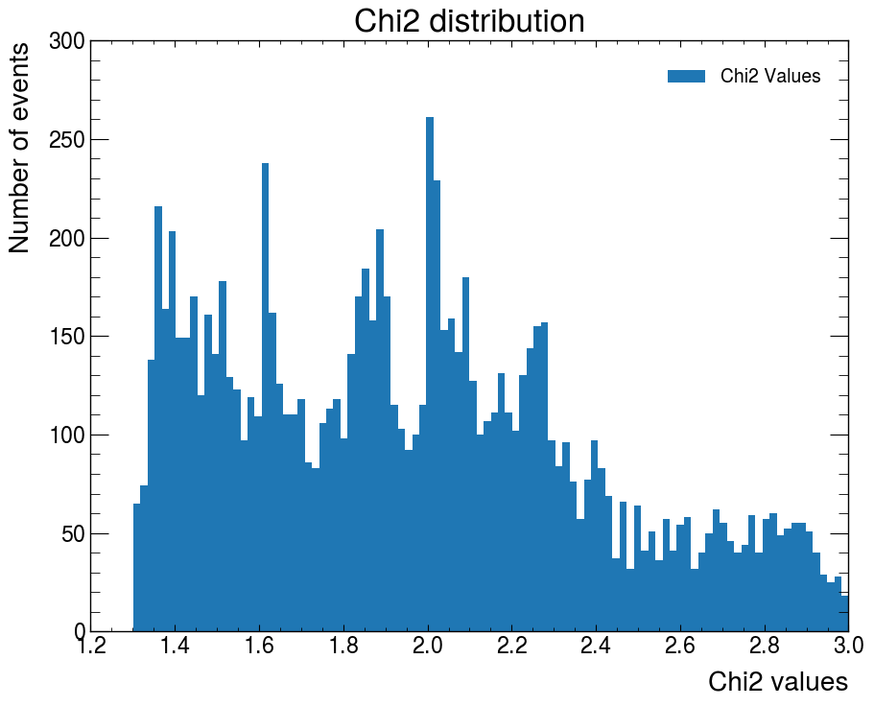
Region 4

Slide 18
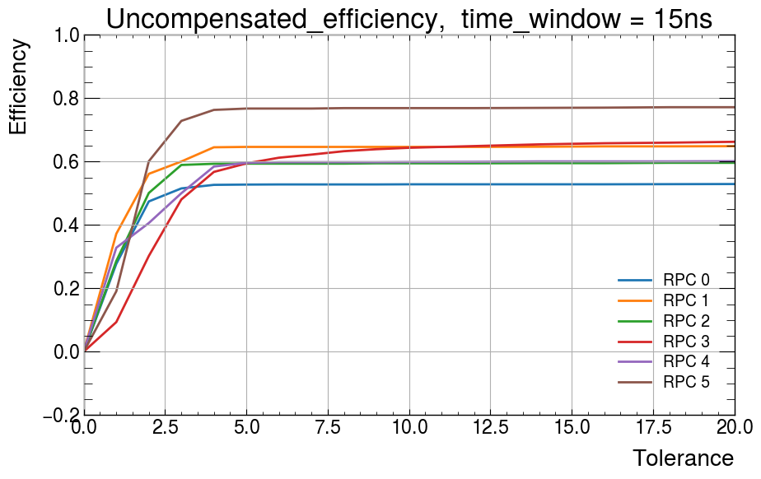
[2314, 1718, 1923, 1116, 1604, 1413]
Most events are packed here. Shape resembles what was seen with previous data.

Slide 19
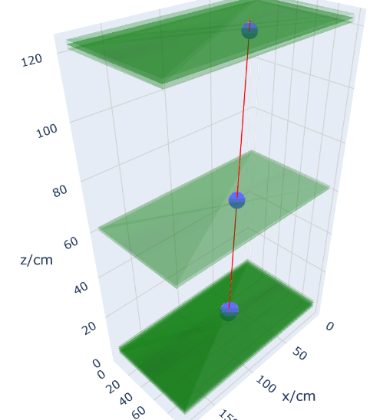
Semi-Random selected events
[[70.44375000000001, 40.2894, 0.6], [70.44375000000001, 40.2894, 1.8],
[70.44375000000001, 43.2738, 3.0],
[73.20625000000001, 52.227, 61.8],
[73.20625000000001, 61.1802, 121.8]]
All events reasonable, this is the ‘good region’ in terms of no anomalous behavior occurs
Instead of saying our chi2 range is one strip, shouldn’t it be 3? Since we are looking at clusters?

Slide 20
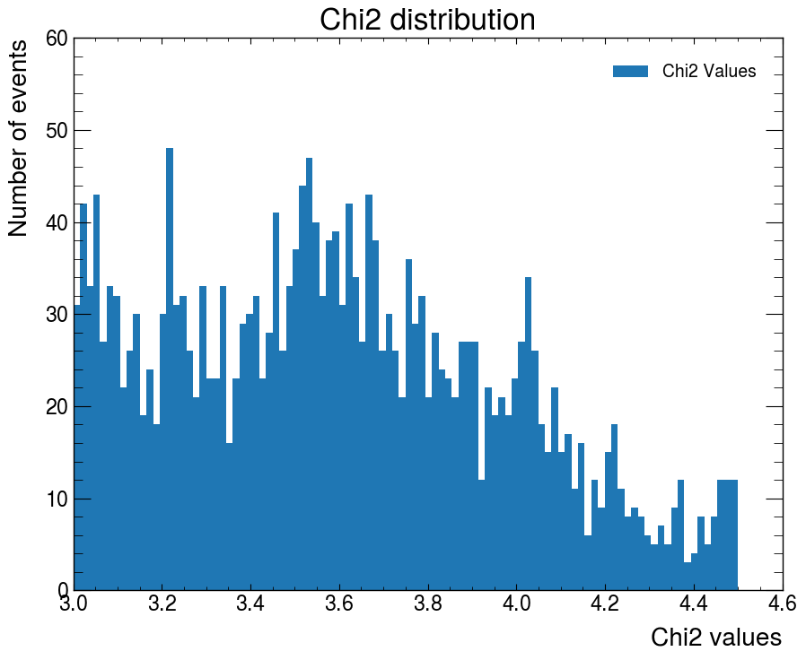
Region 5

Slide 21
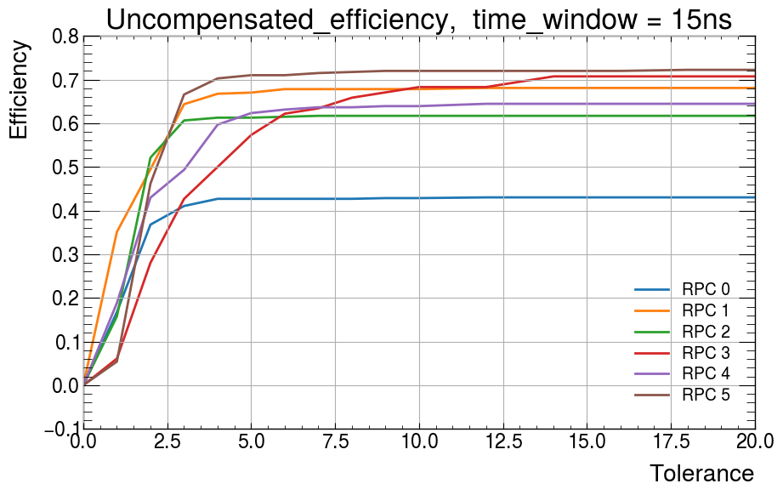
[609, 376, 470, 82, 377, 407]
Low RPC3 count for the same reason, this region of chi2 is not favored by RPC3 due to detector resolution

Slide 22
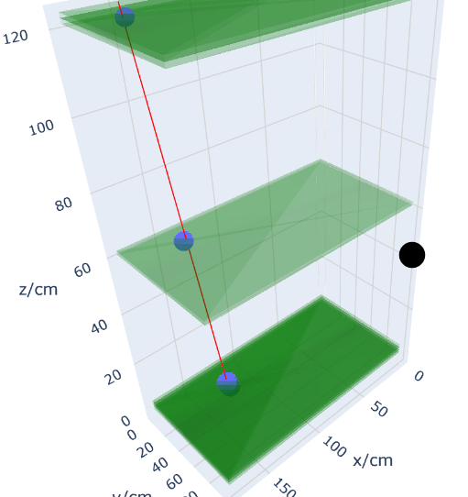
Semi-Random selected events
[[125.69375000000001, 25.3674, 0.6], [125.69375000000001, 22.383, 1.8], [128.45625, 25.3674, 3.0],
[142.26875, 19.3986, 61.8], [153.31875000000002, 16.4142, 121.8]]
Misalignment in triplet caused this increased Chi2 value

Slide 23
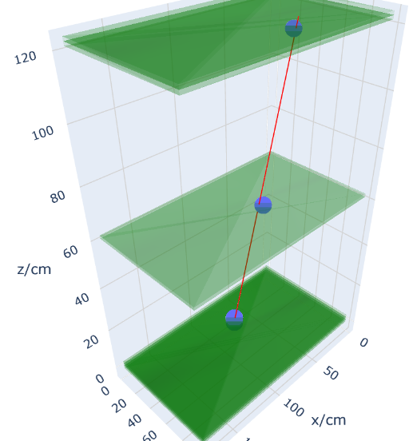
Semi-Random selected events
[[75.96875, 28.3518, 0.6],
[75.96875, 28.3518, 1.8],
[75.96875, 28.3518, 3.0],
[67.68125, 52.227, 61.8],
[64.91875, 70.1334, 121.8]]
Caused simple by the triplet and doublet not located at the proper location. Same as before
Using first time instead of centre of cluster failing us?

Slide 24
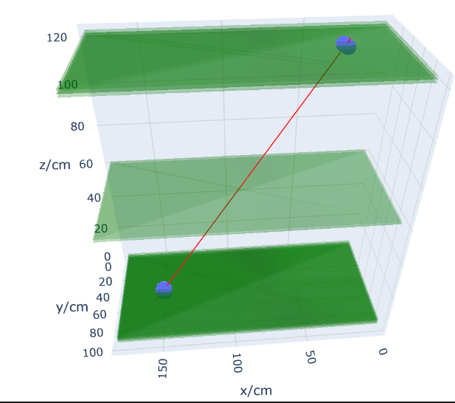
Semi-Random selected events
[[150.55625, 46.2582, 0.6],
[150.55625, 46.2582, 1.8],
[150.55625, 49.242599999999996, 3.0], [31.76875, 40.2894, 121.8],
[34.53125, 40.2894, 123]]
RPC3 efficiency high, so these should all be real events

Slide 25
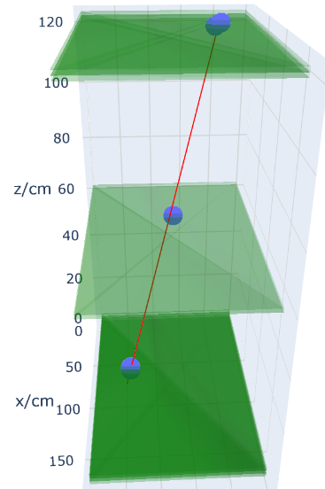
Semi-Random selected events
[[73.20625000000001, 22.383, 1.8], [73.20625000000001, 22.383, 3.0], [56.63125, 52.227, 61.8],
[42.81875, 76.1022, 121.8], [45.581250000000004, 79.0866, 123]]
RPC0 should clearly be there, but it is simply not.. This is simply because it is inefficient…

Slide 26
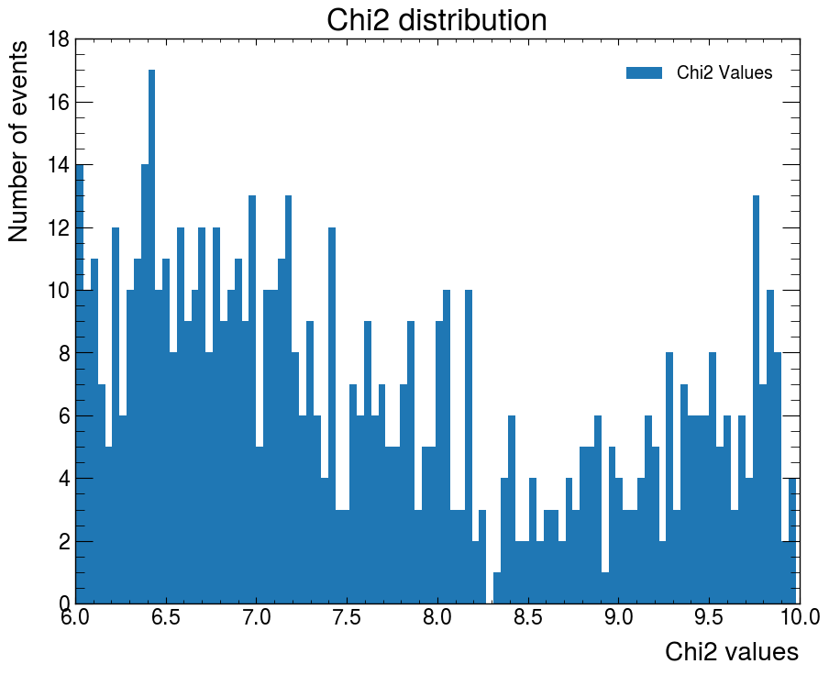
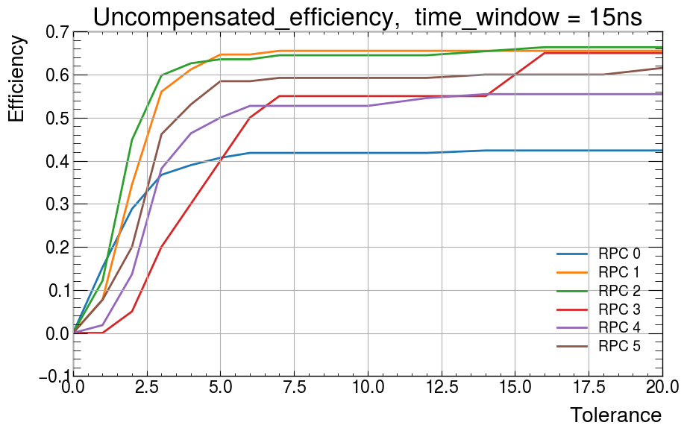
Trash
[177, 116, 107, 20, 110, 130]

Slide 27
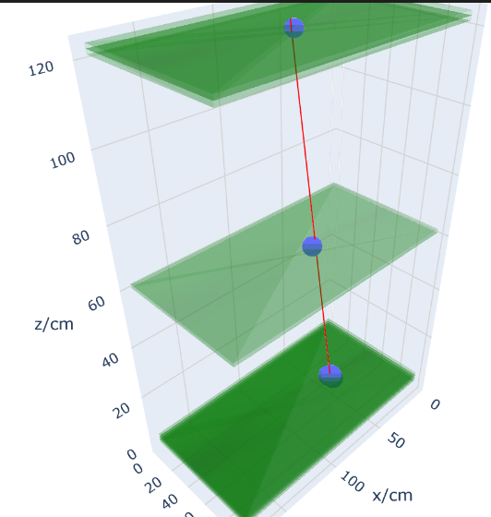
Semi-Random selected events
[[45.581250000000004, 49.242599999999996, 0.6],
[48.34375, 46.2582, 1.8],
[48.34375, 49.242599999999996, 3.0], [73.20625000000001, 49.242599999999996, 61.8],
[89.78125, 49.242599999999996, 123]]
Maybe not that bad…. These are events that are more misaligned than others.
The increase in possible combinations smudges the chi2, no peaks seen

